Slide 1
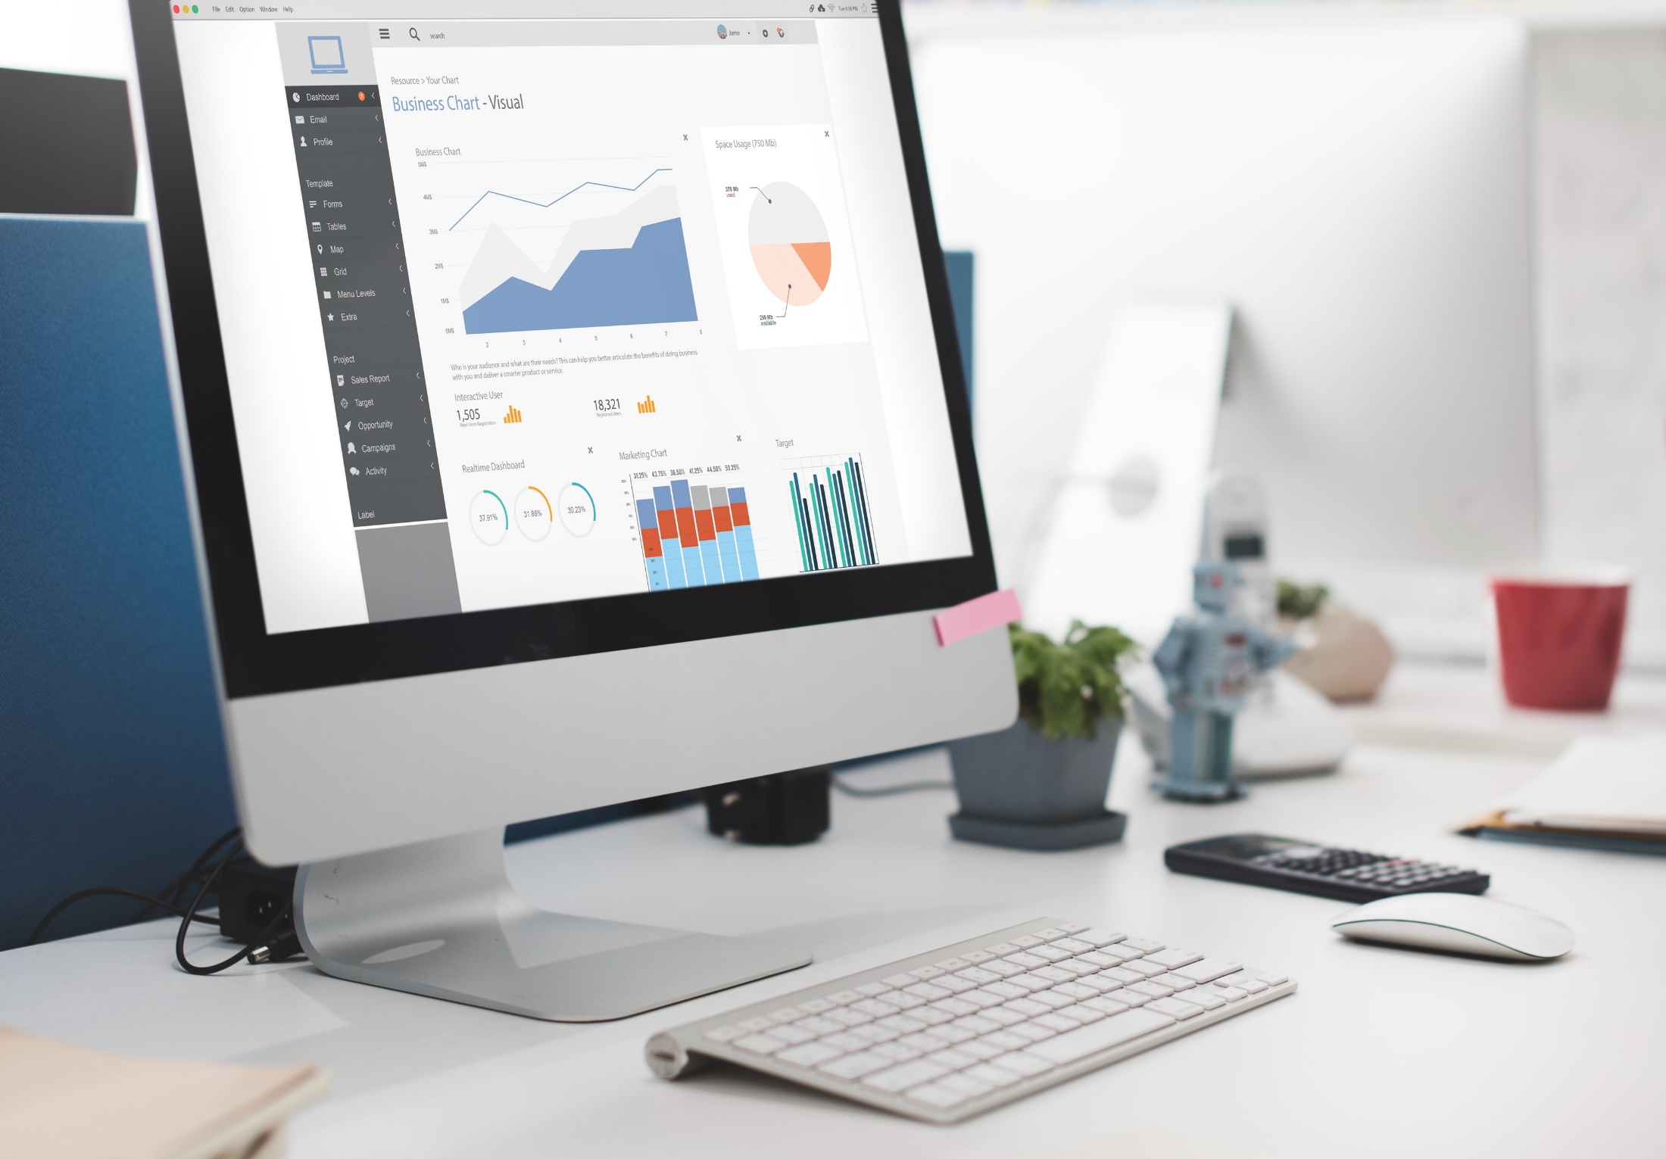
Josephine A | Data Analyst
Data Analysis Presentation
by
JOSEPHINE JUMOKE AKINLABI

Slide 2
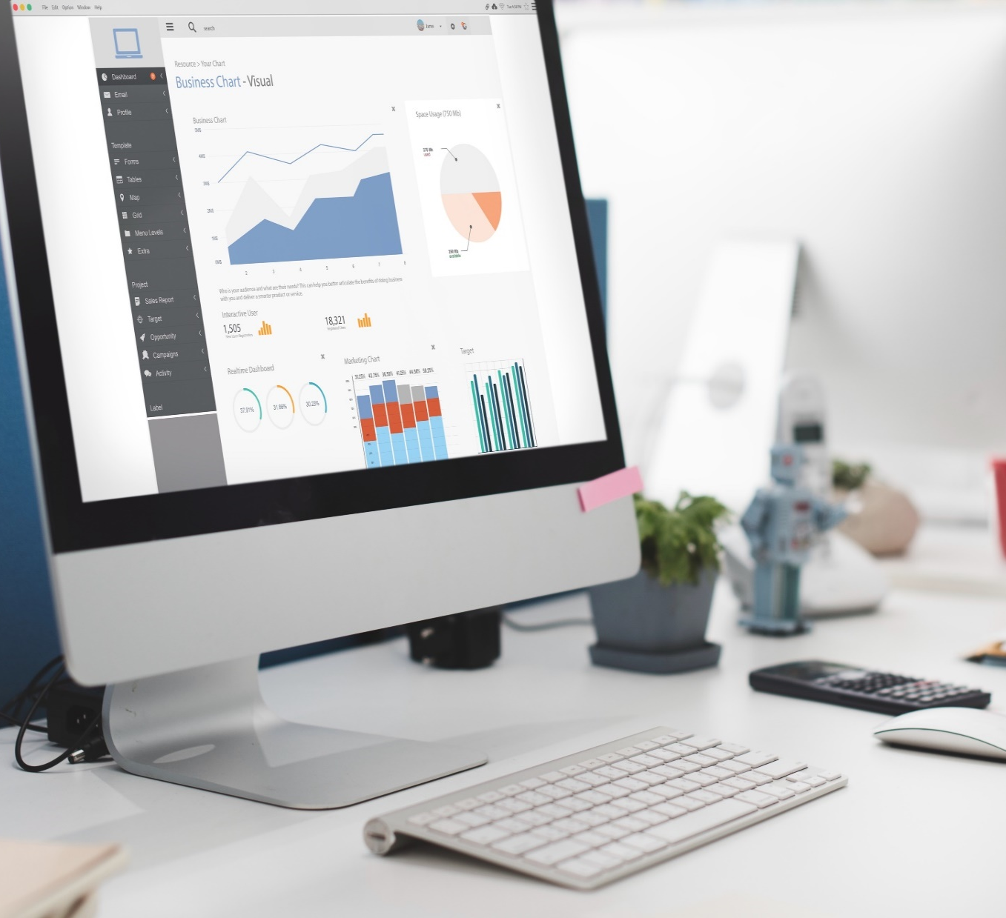
Contents​
Introduction​
Importance of Data Analysis​
Data Analysis Process​
Data Collection
Data cleaning and Preparation​
Data Testing​
Data Analysis and Visualizations​
Examples of own work​
Qualifications/Skills​
Questions and Answers​

Slide 3
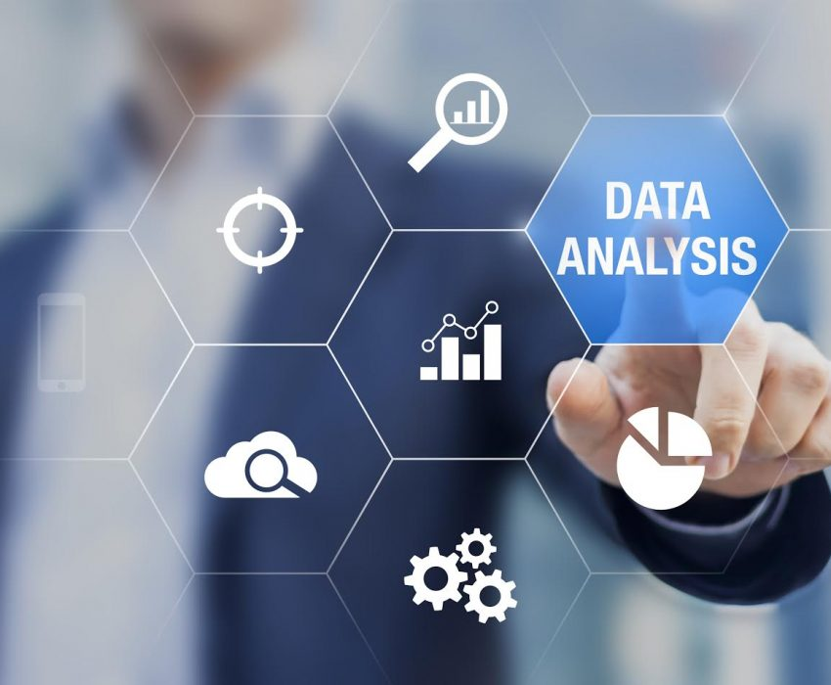
Introduction
Josephine A | Data Analyst
The purpose of this presentation is to showcase my skills and experience in data analysis, reporting, and visualization.
In this presentation, I will walk you through some of my key projects and explain the process I follow to transform the data into actionable insights. I will highlight how I have used tools like Power BI, Tableau, SQL, Excel to drive data-driven decision-making, enhance operational efficiency, and deliver impactful results.

Slide 4
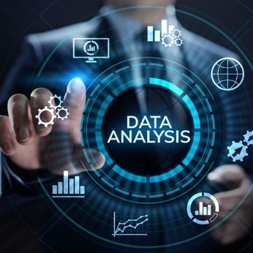



Why Data Analysis ?
Josephine A | Data Analyst
Ample Experience in data Visualization tools
Passion for Analytics
Identify trends and opportunity
Data Driven Decision
5 years experience in Data Analysis
Worked on Various Data Project
Enhances Operational Efficiency
Empower Data Driven Decision making

Slide 5


Data Analysis Process​
Josephine A | Data Analyst
1. Steps
2. Tools
Define Problem/Objective
Collect data
Exploratory Data Analysis (EDA)
Data Transformation
Data Validation
Model and Analysis
Interpret Results
Data Visualization and Reporting
Review and Feedback
Excel
SQL
Tableau and Power Bi
Data Integration and ETL Tools

Slide 6

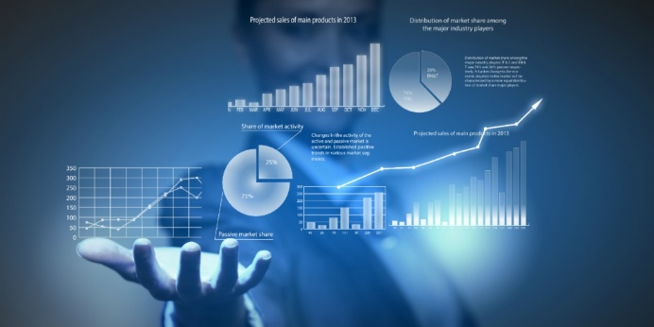


Data Collection​
Josephine A | Data Analyst
SQL
Web Scraping
Flat files
Cloud Data Warehouse
Explain how you collect and gather data, including any methods or tools you use to extract data from different sources.​
To extract data from websites that do not provide an API. This is useful for gathering unstructured data like product listings, reviews, or news articles
To query relational databases such as MySQL, PostgreSQL to extract structured data.
I often work with data in flat files like CSV, Excel (XLSX), or JSON formats that can be downloaded or shared.
For large-scale data, I work with data warehousing platforms like Azure SQL Data Warehouse to access and query massive datasets stored in the cloud.

Slide 7

Josephine A | Data Analyst
Data Cleaning and Preparation
Understand Data/Profile data
Remove Duplicate Records
Handling Missing Data
Data Format
Correct Data Inconsistence
Handling Outliers
Transforming Data
Data Validation

Slide 8

Data Testing​
Josephine A | Data Analyst
Ensures data accuracy​
Improves data quality​
Reduces risks​
Saves time and resources​
Improves confidence in the data​
Supports compliance

Slide 9
Data Analysis and Visualisation ​
Josephine A | Data Analyst
Tableau
Powerful tool for interactive Dashboard, visualizations and business intelligence
Drag and Drop interface
Great for Large Dataset
Story telling
Visualization :
Line and Bar chat
Histogram
Heat and Tree Map.
Power Bi
Great for connecting to various data sources and generating automated reports.
Data Transformation using Power Query
Integration with Excel
Visualization:
Interactive charts
Tables
KPI Indicators
Excel
For simple visualizations and quick insights
Great for smaller datasets building models and running basic analysis.
Visualization:
Pivots Table and charts
Histogram
Box Plot

Slide 10

Data Interpretation and Reporting​
Josephine A| Data Analyst
Interpretation of data and Drawing Actionable conclusion
Understanding the business objective & KPI
Identify Pattern and Trends
Draw Conclusion and Insights
Relate Finding to business Goals
Engage Stakeholder Across all Business level
Fostering collaboration and enabling data-driven decision-making across all levels of the organization.
Communicate Findings to Stakeholders
Tailor the communication based on the audience
Tableau and Power BI are used to create interactive dashboards that allow stakeholders to explore the data themselves
Excel and created Power Point
Email Briefing

Slide 11
Collaboration and Communication​
Josephine A | Data Analyst
Work closely with stakeholders from different departments, such as marketing, sales, operations, finance, and product teams, to gather requirements, define objectives, and ensure that data analysis aligns with the broader business strategy
I customize my reports and presentations based on the needs of the audience. For example, when reporting to senior executives, I focus on high-level insights, actionable recommendations, and key performance indicators (KPIs).
I engage stakeholders early in the process by gathering their input on what metrics or outcomes are most important to them. This ensures that the analysis is focused on what matters to the business

Slide 12
Example of Power BI Visual​

Slide 13
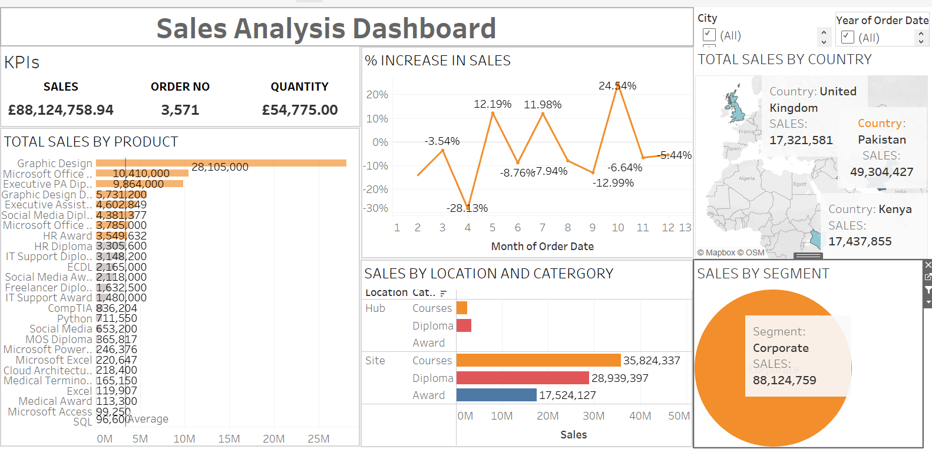
Example of Tableau BI Visual​

Slide 14

Qualifications and Skills ​
Josephine A | Data Analyst
Data Analysis:
Excel, SQL, Power BI, Tableau, Phyton
BSc in Accounting (2018)
MSc in Public Health (2023)
DataCamp Certification:
Data Analyst in Power Bi (2024)
Introduction to SQL (2024)
Introduction to Tableau (2024)

Slide 15

What I
Josephine A | Data Analyst
Strong analytical skills​
Attention to detail​
Strong communication skills ​
Experience in data visualization​
Problem-solving skills​
Team player​
Continuous learning​
Overall - unique set of skills and experience​

Slide 16
Josephine A | Data Analyst
THANK YOU
QUESTIONS?

